Slide 1

Not Sure how you Should React
SharePpoint Fest DC 2017

Slide 2




Ryan Schouten
Utah SharePoint User Group President
Worked with SharePoint for 10 years
I have experience with SharePoint 2003 – 2016
I have worked with ASP.Net for 15 years
Contact Information
Ryan@sharepointknight.com
@shrpntknight
http://www.sharepointknight.com

Slide 3

Office365 Implementations
Custom SharePoint Development
Responsive Design
Intranet Design/Implementations

Slide 4
REACt key Components
Build Components
Re-Render, Don’t Mutate
Fast Virtual
DOM

Slide 5
REACT Components
Small, reusable widgets of your application
UI layout and the UI logic are tightly coupled
Can be individual or have a parent/child relationship
Use state for storing data within the component
Use props to pass data and events to a child component

Slide 6
React Basics
Need to reference the React libraries
React
React-dom
Your markup is returned from the render method

Slide 7
Markup in React
Added as part of your jsx or tsx
Per XHTML standard, React assumes lowercase tags are default html
Your components are added as mixed case tags

Slide 8
Props and State
Props
Using props to pass data to your components
Props are read-only
State
State allows us to receive/work with changeable data
Set initial state in constructor
Do not update directly use setState
Updates are merged

Slide 9
Lifecycle
constructor()
Used to set initial state
Best Practice don’t load external data here
componentDidMount()
Used to setup component and load external data
compononentWillUnmount()
Used for clean up

Slide 10
DOM Events
Events we add to our markup are not the standard HTML events
Events are camelCased not lowercased like HTML onclick vs onClick
You pass in the function to the event handler not a string

Slide 11
Conditional Rendering
Several methods
Store element as variable
Null elements will not be loaded
Inline if
Must use following syntax
Condition && <element>
Tertiary operator
(condition)?<element1 />:<element2 />

Slide 12
Lists of Items
Use the JavaScript map command
Object.map((item) => { return <element /> })
Make sure you add a key attribute to help React with rendering and handling changes
Object.map((item) => { return <element key={item.ID} /> })
Keys must be unique among siblings

Slide 13
Forms and Output
Use onChange event to get the changed values
Output content using {}

Slide 14
React and SharePoint
Load external resources in your HTML file
Load HTML file in content editor
Use the SP-PNP-JS library for working with SharePoint data

Slide 15
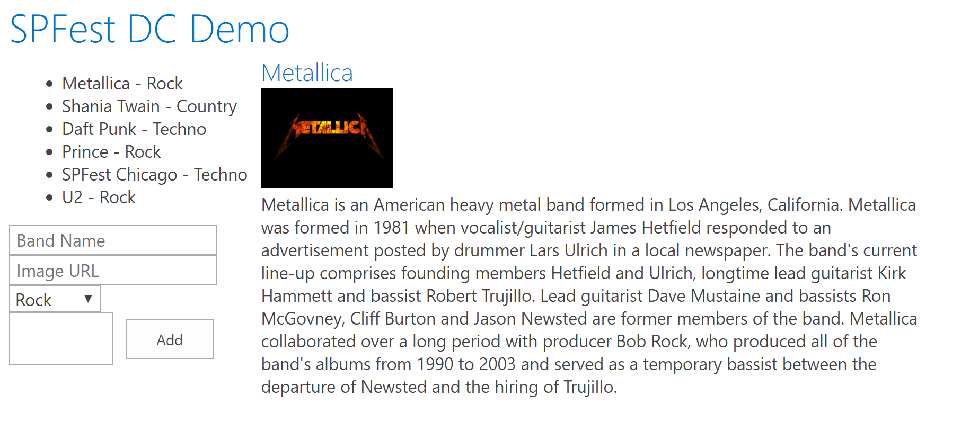
Thinking in React
Break things into reusable components

Slide 16



Office UI Fabric
Fonts, icons
Colors
Front end experiences for SharePoint
Powers OOB experiences
Available out of the box
Design web part seamlessly
Office UI Fabric React for rich set of reusable controls
Components

Slide 17
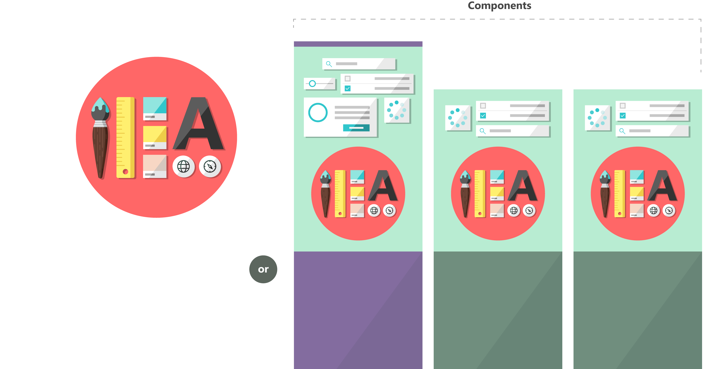

Fabric and its sub-projects
Fabric Core
Fabric React
Fabric JS
ngFabric
Fabric iOS
Core elements of the design language including icons, colors, type, and the grid
Robust, up-to-date components built with the React framework.
Simple, visuals-focused components that you can extend, rework, and build on.
Community-driven project to build components for Angular-based apps.
Native Swift colors, type ramp, and components for building iOS apps.

Slide 18
Demo

Slide 19

Questions

Slide 20
Thanks
Thank your for attending SharePoint Fest
Contact Information
Ryan@sharepointknight.com
@shrpntknight
http://www.sharepointknight.com

Slide 21



Surveys
Learn from the Top SharePoint Experts
Feedback Please!
Session Surveys via Event App
Select “Schedule” -> Select Session -> Scroll to “Session Survey”
Download the App:
Event URL https://crowd.cc/spfdc17
Your App URL https://crowd.cc/s/zN7K
Or search for “SharePoint Fest” in App Store
SharePoint Fest
DC 2017

